Slide 1

The Role of the Field Referee
Focus on club and county level events

Slide 2
Please write any questions in your chat box and we’ll aim to deal with them as we go
What we aim to cover:
    Some definitions
    Accountability
    Roles – National vs Local
    Tasks – before, during and after the meeting
    What can possibly go wrong…? (three scenarios)

Slide 3
The Referee (WA Rule 18)
Ensures that the Rules and Regulations are observed
Rules on any protest or objection
Decides on any matters not covered in the Rules
May overrule a decision of a Judge.
Plus…
(Field Ref - from 2018-20 UKA Rule Book):
Has charge of all field events
Allocates judges to events and duties
Ensures safe practice
Checks final results

Slide 4
Management team
NB Roles of Equipment Officer and Clerks of Course not in WA Rules
Comp Director / Meeting Manager (Rules 14/15)
Technical Manager
(Rule 16)
CD plans the technical organisation of a competition, ensures the plan is accomplished and resolves technical problems
CD directs interaction between participants and is in contact with all key officials.
MM responsible for the correct conduct of Competition.
The MM ensures that only authorised persons are allowed in the centre of the Field of Play.
Ensures that track, runways, sectors and all equipment and implements conform to the Rules
Responsible for placement and removal of venue equipment and implements
Ensures the technical presentation of competition areas is in accordance with plan
Checking and marking of personal implements permitted for the competition according to Rule 32.2
Certification under Rule 10.1

Slide 5
The Technical team
UKA Supplementary document being updated
Equipment Officer
Clerks of Course
Ensures all venue equipment is prepared and available
Checks/marks all venue and personal implements
Ensures equipment is removed, cleaned and stored after use
Ensures any implement involved in a record is re-checked.
Ensure that all venue markings are in accordance with the Rules
Ensure that all equipment is in a fit state (both track and field)
Responsible for the placement and removal of equipment and implements
Ensures track/hurdles etc correctly set

Slide 6
Field Ref Accountability
To athletes – provide a fair competition, according to the Rules
To officials – allocate a balance of duties, within their capabilities, some stretch
To management – deliver the event according to plan
To spectators – Good competition with no undue delays
TO ALL – A SAFE, ENJOYABLE, WORTHWHILE EVENT

Slide 7
Other roles (Start team, Timekeepers, PF, Call Room, seeding, jury etc) omitted for clarity
Comp Director
Mtng Manager
The model – National
and Regional Level
Field Ref
Tech Mgr
Track Ref
Field Judges
Equip Officer
Track Judges
Clerks of Course

Slide 8
The reality – Local
and County Level
Meeting Manager
Field Ref
Track Ref
Often also TM,
EO and CofC
Field Judges
Track Judges

Slide 9
Tasks – Before, during and
after the meeting

Slide 10
Tasks – Prior to the day
Recruit officials
Liaise with MM re timetable
Agree number of attempts / progressions / ties etc
Plan scope of checks on personal implements
Create officials’ duty sheet*
Create signing-in sheet
Check all areas / equipment*
Create script for announcer
Prepare field cards

Slide 11
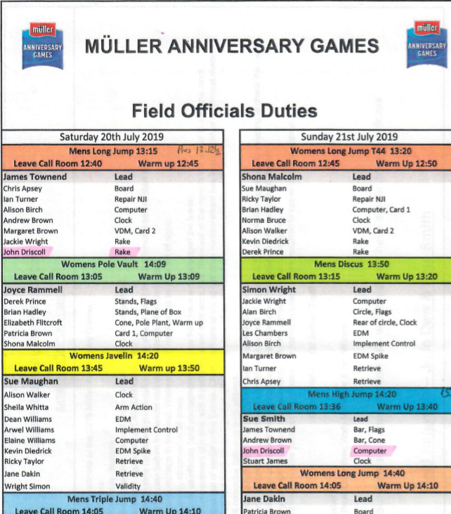
Tasks – Prior to the day
Recruit officials
Liaise with MM re timetable
Agree standards / number of attempts / ties etc
Plan scope of checks on personal implements
Create officials’ duty sheet*
Create signing-in sheet
Check all areas / equipment*
Create script for announcer
Prepare field cards

Slide 12
Tasks – Prior to the day
Recruit officials
Liaise with MM re timetable
Agree standards / number of attempts / ties etc
Plan scope of checks on personal implements
Create officials’ duty sheet*
Create signing-in sheet
Check all areas / equipment*
Create script for announcer
Prepare field cards

Slide 13
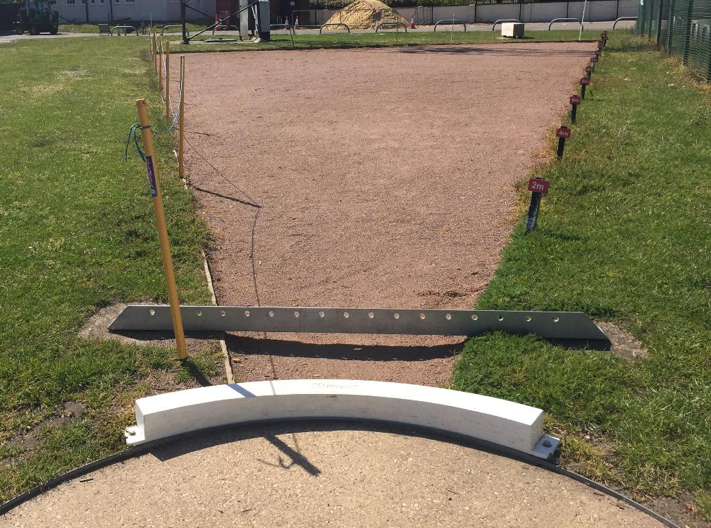
Tasks – Prior to the day
Recruit officials
Liaise with MM re timetable
Agree standards / number of attempts / ties etc
Plan scope of checks on personal implements
Create officials’ duty sheet*
Create signing-in sheet
Check all areas / equipment*
Create script for announcer
Prepare field cards

Slide 14
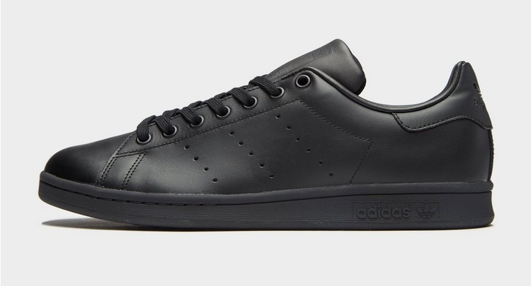
Tasks – On the day (before first event)
Arrive early!
Check all areas / barriers
Check all equipment / implements
Liaise with First Aiders
Distribute duty sheet
Brief officials (sun/noise)*

Slide 15
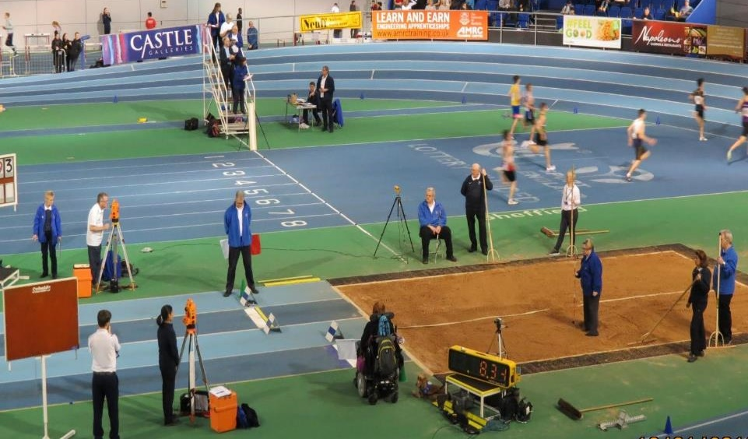
Tasks – On the day (before first event)
Arrive early!
Check all areas / barriers
Check all equipment / implements
Liaise with First Aiders
Distribute duty sheet
Brief officials (sun/noise)*

Slide 16
Tasks – During the meeting
Monitor all events
Check that all officials are coping (+ taking breaks)
Deal with any delays
Deal with any problems
Collect and check all results
Log actual start and finish times for each event
Make notes for any reports on officials
Check measurement of any records + paperwork

Slide 17
Tasks – After the meeting
Clear everything away
Note any problems / issues for the future
Complete reports and RoE

Slide 18
A handful of examples from recent years
What can possibly
go wrong…?

Slide 19
County Schools CE Championship (April)
Temp 4º C
Wind SE gusting to 25 mph
Hail showers
Owing to deteriorating weather, you’re concerned about the safety of running
the Junior and Inter Girls’ HJ
Options:
Go ahead
Postpone
Cancel

Slide 20
Lower Age Group YDL meeting
Venue in country park with trees around perimeter. Final meeting before track re-laid and clubhouse rebuilt; local authority has not power-washed track or runways.
After earlier rainfall, weather is overcast but dry. During warm-up, an athlete slips on the javelin runway and sustains a minor injury. The lead official asks for your advice.
Options:
Go ahead
Modify
Cancel

Slide 21
County AA Championship
Owing to low entries, all age groups are on one card for Men’s Hammer.
Part-way through Round 2, Retriever alerts Lead Official that implement just thrown is wrong weight for that age group. After discussion, it’s clear that this may not be the only time this has happened.
The Lead asks you what to do next. Options?

Slide 22
Enjoy your role as a Field Referee!
Thank you for attending.

Slide 23
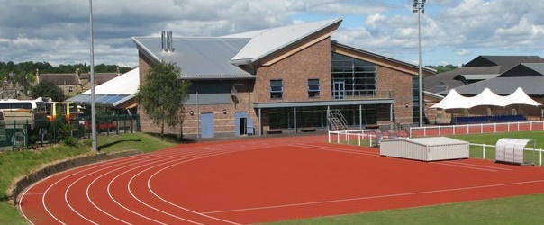
EAP International Combined Events Meeting
Insufficient HJ runway length for French Decathlete

Slide 24
Schools Regional CE Championship
Venue had ordered new crossbars (3x HJ; 3 x PV).
Delivered day before event and not opened.
You live too far from venue to do pre-meeting checks.
When you open package on morning of championship,
you find that all six crossbars are for PV…

Slide 25
Enjoy your role as a Field Referee!
Thank you for attending.

